Slide 1

Mini Project-I (K24MCA18P) Odd Semester Session 2024-25
Gym Management System
MANISH KUMAR (2426MCA669)
GOURAV CHAUHAN (2426MCA1916)
HARSH SINGH (2426MCA2027)
Project Supervisor:
Supervisor Name-Arpit Dogra
Designation- Assistant Professor

Slide 2
Contents
S.No | Topics
1. | Introduction
2. | Objectives of the project
3. | Literature Review
4. | Technology requirements
5. | Modules
6. | Workflow
7. | Reports
8. | References
Notes:
Font Styles: Times New Roman + Font Size: 25

Slide 3
Introduction
Welcome to FITNESS POINT, your ultimate destination for fitness and wellness.
Our website offers a comprehensive platform for fitness enthusiasts of all levels.
Track your progress and stay motivated throughout your fitness journey.
Suitable for both beginners and experienced athletes.
Designed to help you stay healthy, strong, and fit.
User-friendly interface ensures easy navigation and a seamless experience.
Achieving your dream that has never been easier.
Notes:
Font Styles: Times New Roman + Font Size: 25

Slide 4
Objective of the Project
Provide Accessible Fitness Solutions To offer convenient and accessible fitness resources for users of all levels, making it easy to achieve fitness goals from anywhere.
Deliver Personalized Workout Plans To create customized workout routines that cater to individual fitness needs, ensuring effective and tailored progress.
Promote Healthy Lifestyles To encourage users to adopt healthier habits by offering comprehensive fitness programs, including exercise and nutrition guidance.
Enhance User Motivation and Engagement To build a supportive online community where users can track their progress, share experiences, and stay motivated
Integrate Technology for Better Results To leverage wearable technology and fitness tracking tools, helping users monitor their performance and improve consistency.
Notes:
Font Styles: Times New Roman + Font Size: 25

Slide 5
Literature Review
Rise of Online Fitness Platforms The use of online fitness websites has surged, offering users convenience and flexibility.
Effectiveness of Virtual Workouts Studies show that online workouts can be as effective as in-person training, especially with consistent.
User Engagement in Online Fitness Communities Online communities enhance motivation and accountability, leading to better fitness outcomes.
Importance of Personalized Plans Customized workout and nutrition plans improve user adherence and results.
Fitness Tracking Technology Wearable devices and apps boost motivation and progress tracking, aiding user engagement.
Impact of Nutrition Guidance Combining fitness with proper nutrition leads to better results, supported by many online platforms.
Notes:
Font Styles: Times New Roman + Font Size: 25

Slide 6
Technology (Hardware Requirements)
Device Compatibility
Smartphones, Tablets, Laptops, or Desktops: FIT INDIA is accessible through any device with internet access, ensuring flexibility for users to follow workouts and track progress.
2. Internet Connection
A stable internet connection is required for seamless browsing, accessing workout videos, downloading personalized plans, and participating in live sessions.
3. Basic Home Workout Equipment
Although most workouts can be done without equipment, having basic items like dumbbells, yoga mats, can enhance the workout experience.
4. Audio/Visual Accessories (Optional)
Headphones or Bluetooth speakers for better audio experience during workout videos.
Notes:
Font Styles: Times New Roman + Font Size: 25

Slide 7
Technology (Software Requirements)
Hardware Requirements
Processor: Minimum 2 GHz dual-core or higher for efficient server-side processing.
RAM: 4 GB or more to ensure smooth execution of web pages and database operations.
Storage: 500 GB HDD/SSD (preferably SSD) for storing system data and ensuring fast performance.
Software Requirements
Frontend: HTML, CSS, JavaScript for responsive design and interactivity.
Backend: Django (Python) for secure and scalable development.
Database: MySQL/PostgreSQL for efficient data management.
Notes:
Font Styles: Times New Roman + Font Size: 25

Slide 8
Modules
1.HOME
2. LOGIN
3. WORKOUT PLANS
4. BLOG
5. CLASSES DETAILS
6. SIGNUP
7.TRAINER DETAILS
Notes:
Font Styles: Times New Roman + Font Size: 25

Slide 9
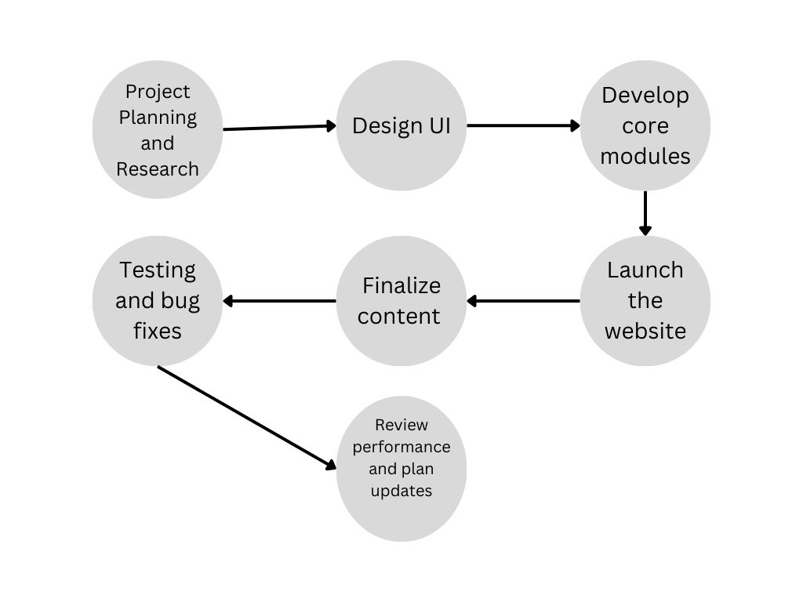
Workflow/Gantt Chart
Notes:
Font Styles: Times New Roman + Font Size: 25

Slide 10
Reports
Login Page
Purpose: Secure user access.
Features: Email/password and social media login, password recovery, registration link.
2. Contact Page
Purpose: User communication.
Features: Contact form, email/phone details, social media links.
3. Services Page
Purpose: Inform about services.
Features: Personalized plans.
Notes:
Font Styles: Times New Roman + Font Size: 25

Slide 11
References
Fitness World
Fitness World. Welcome to Fitness World. Retrieved from https://www.fitnessworld.com
2. Gym Life Gym Life. Your Fitness Journey Starts Here. Retrieved from https://www.gymlife.com
3. FitNation FitNation. Explore Our Services. Retrieved from https://www.fitnation.com
4. MDN- https://developer.mozilla.org/en-US/
Notes:
Font Styles: Times New Roman + Font Size: 25

